Slide 1
Unit 3
Concept of Data Science

Slide 2
Traits of Big data
Big Data contains a large amount of data that is not being processed by traditional data storage or the processing unit.
It is used by many multinational companies to process the data and business of many organizations. The data flow would exceed 150 exabytes per day before replication.
There are five v's of Big Data that explains the characteristics.
5 V's of Big Data
Volume
Veracity
Variety
Value
Velocity

Slide 3
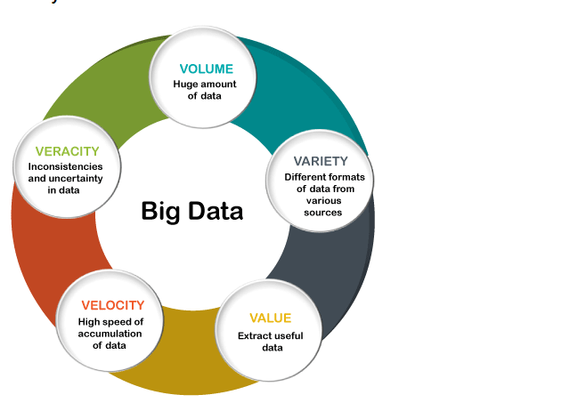

Slide 4
Traits of Big Data
Volume
The name Big Data itself is related to an enormous size. Big Data is a vast 'volumes' of data generated from many sources daily, such as business processes, machines, social media platforms, networks, human interactions, and many more.
Facebook can generate approximately a billion messages, 4.5 billion times that the "Like" button is recorded, and more than 350 million new posts are uploaded each day. Big data technologies can handle large amounts of data.

Slide 5
Variety
Big Data can be structured, unstructured, and semi-structured that are being collected from different sources. Data will only be collected from databases and sheets in the past, But these days the data will comes in array forms, that are PDFs, Emails, audios, SM posts, photos, videos, etc.
The data is categorized as below:
Structured data: In Structured schema, along with all the required columns. It is in a tabular form. Structured Data is stored in the relational database management system.
Semi-structured: In Semi-structured, the schema is not appropriately defined, e.g., JSON, XML, CSV, TSV, and email. OLTP (Online Transaction Processing) systems are built to work with semi-structured data. It is stored in relations, i.e., tables.
Unstructured Data: All the unstructured files, log files, audio files, and image files are included in the unstructured data. Some organizations have much data available, but they did not know how to derive the value of data since the data is raw.
Quasi-structured Data:The data format contains textual data with inconsistent data formats that are formatted with effort and time with some tools.

Slide 6
Veracity
Veracity means how much the data is reliable. It has many ways to filter or translate the data. Veracity is the process of being able to handle and manage data efficiently. Big Data is also essential in business development.
For example, Facebook posts with hashtags.
Value
Value is an essential characteristic of big data. It is not the data that we process or store. It is valuable and reliable data that we store, process, and also analyze.

Slide 7
Advantages of Big Data
Better Decision Making
Reduce costs of business processes
Fraud Detection
Increased productivity
Improved customer service
Increased agility

Slide 8
Web Scrapping
Suppose you want some information from a website? Let’s say a paragraph on Kolhapur! What do you do? Well, you can copy and paste the information from Wikipedia to your own file.
But what if you want to get large amounts of information from a website as quickly as possible? Such as large amounts of data from a website to train a Machine Learning algorithm?
In such a situation, copying and pasting will not work! And that’s when you’ll need to use Web Scraping.

Slide 9
Web scrapping
What is web scraping
Web scraping is an automatic method to obtain large amounts of data from websites.
Most of this data is unstructured data in an HTML format which is then converted into structured data in a spreadsheet or a database so that it can be used in various applications.
There are many different ways to perform web scraping to obtain data from websites.
These include using online services, particular API’s or even creating your code for web scraping from scratch.
Many large websites, like Google, Twitter, Facebook, StackOverflow, etc. have API’s that allow you to access their data in a structured format.

Slide 10
Web Scrapping
Web scraping is used in a variety of digital businesses that rely on data harvesting. Legitimate use cases include:
Search engine bots crawling a site, analyzing its content and then ranking it.
Price comparison sites deploying bots to auto-fetch prices and product descriptions for allied seller websites.
Market research companies using scrapers to pull data from forums and social media (e.g., for sentiment analysis).

Slide 11
Web Scapping
Scraper tools and bots
Web scraping tools are software (i.e., bots) programmed to sift through databases and extract information. A variety of bot types are used, many being fully customizable to:
Recognize unique HTML site structures
Extract and transform content
Store scraped data
Extract data from APIs

Slide 12
Web Scrap Code
import requests
# Making a GET request
r = requests.get(https://en.wikipedia.org/wiki/Kolhapur/')
# check status code for response received
# success code - 200
print(r)
# print content of request
print(r.content)

Slide 13
Reporting vs. Analysis: What’s the Difference?
Reporting: The process of organizing data into informational summaries in order to monitor how different areas of a business are performing.
Analysis: The process of exploring data and reports in order to extract meaningful insights, which can be used to better understand and improve business performance.

Slide 14
Reporting | Analysis
Reporting translates raw data into information Reporting helps companies to monitor their online business and be alerted to when data falls outside of expected ranges. Good reporting should raise questions about the business from its end users. In summary, reporting shows you what is happening | Analysis transforms data and information into insights. The goal of analysis is to answer questions by interpreting the data at a deeper level and providing actionable recommendations. Through the process of performing analysis you may raise additional questions, but the goal is to identify answers, or at least potential answers that can be tested. n summary, analysis focuses on explaining why it is happening and what you can do about it.

Slide 15
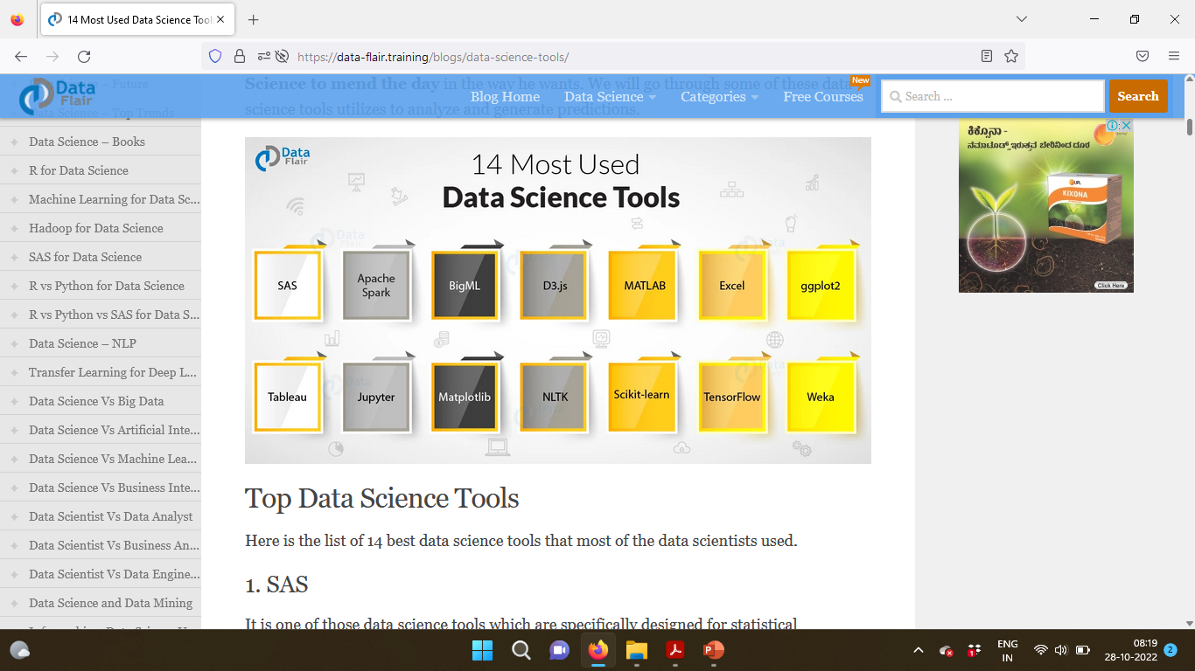
Tools For Data Sciecne
Most Used Data Science Tools for Essential Data Science Ingredients are

